Slide 1
Stranded on an island
The island I would like to be on would be…

Slide 2
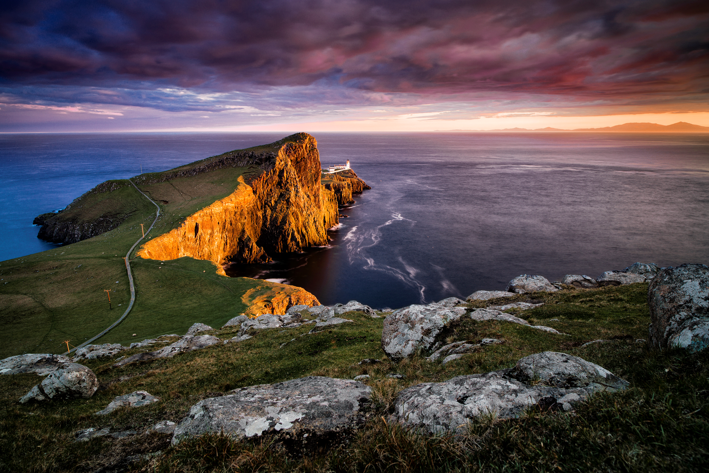

Slide 3
The Isle of Skye
From Isle of Skye to Inverness
3 hours 11 min to drive (127.8 miles)
Inverness is 36 km²
Isle of Skye is 1,656 km²

Slide 4
Interesting facts about Isle of Skye
It is an island in Scotland.
More than 9,000 people live there
Half of the people speak Gaelic
How long is the bridge to Skye?
In 1995, the need to travel by boat to Skye ceased as the mile long (1.6 km) road bridge opened to traffic. This toll bridge replaced the Caledonian MacBrayne ferry service between Kyle of Lochalsh on the mainland and Kyleakin, around 500 meters away on the Island

Slide 5
QUIZ
How many people speak Gaelic?
How far away is it from Inverness?
How do you get to the Isle of Skye from mainland Scotland?

Slide 6
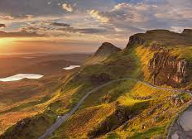
I hope you enjoyed my
PRESENTATION

